Slide 1
Lesson Objective
PBiS focus:
Achieve – Complete all tasks
Learn –be prepared to give a response
Title: Solving equations
Aim – be able to:
Solve linear equations with unknown variables and brackets on both sides.
Plot coordinates on the cartesian plane
Plan:
Review expanding brackets
Switching sides with variables
Plotting coordinates
Need whiteboards and calculators

Slide 2
Expanding brackets – we do
3(2x + 8)
2x(x + 2s + 4)
-3(2c + 4)
-2(-x – 7)

Slide 3
Whiteboards – expanding brackets
3(3x + 4)
2(10 – 4x)
-4(4 + 2d)
4(8x – 6)

Slide 4
Variables on both sides
Simplify both sides
Collect variable terms to left and numbers to right – swap sides swap signs.
Simplify both sides
Divide both sides by coefficient.
State answer
4x + 9 = 5x + 4
2(5v + 2) = 2(3v – 2)
6h + 8 = 4h – 15
3(2d – 9) + 4 = 4(d – 4) + 10

Slide 5
Whiteboards
2(x + 8) = 22
3(x – 2) = 6x – 21
-2(2x + 4) = 4
4(f + 4) = 3(3f – 4) – 2
Exercise books…..

Slide 6
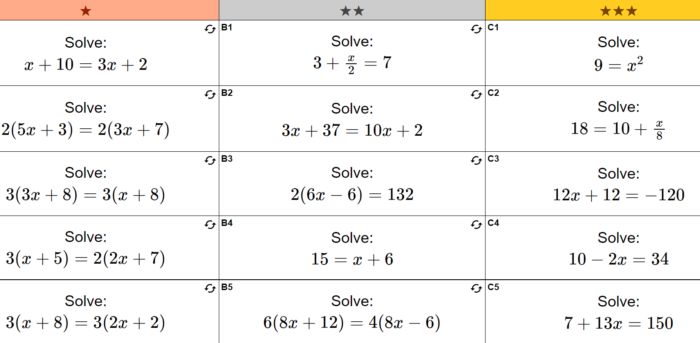

Slide 7
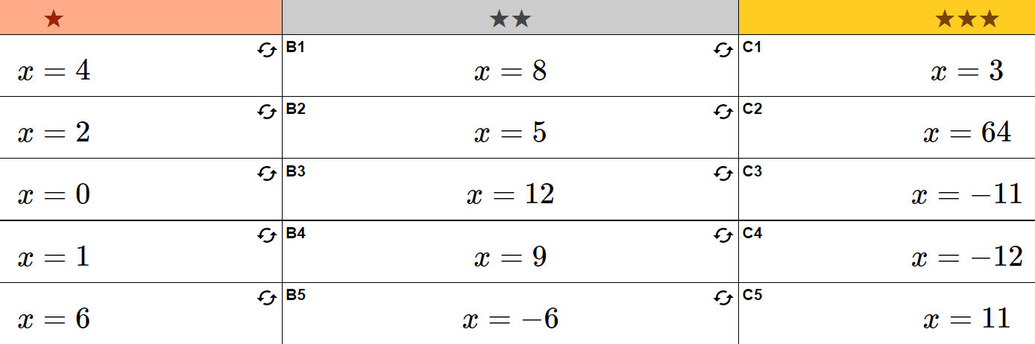

Slide 8
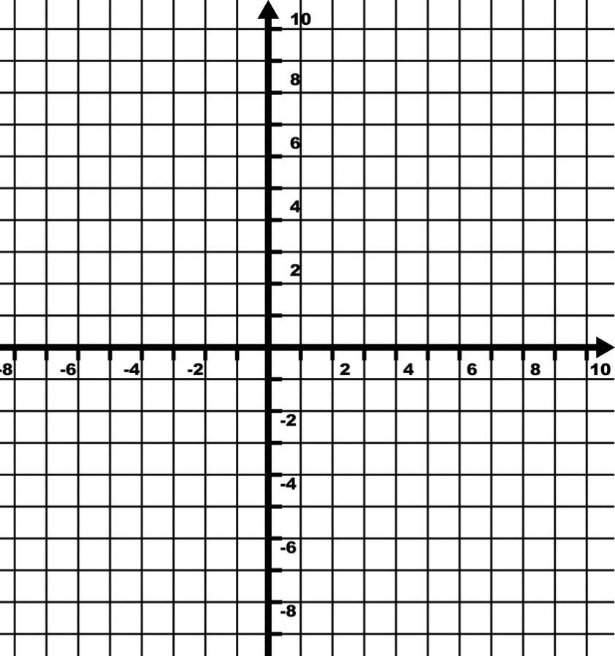
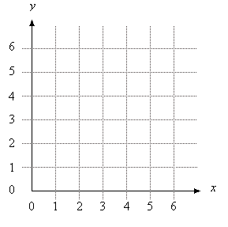
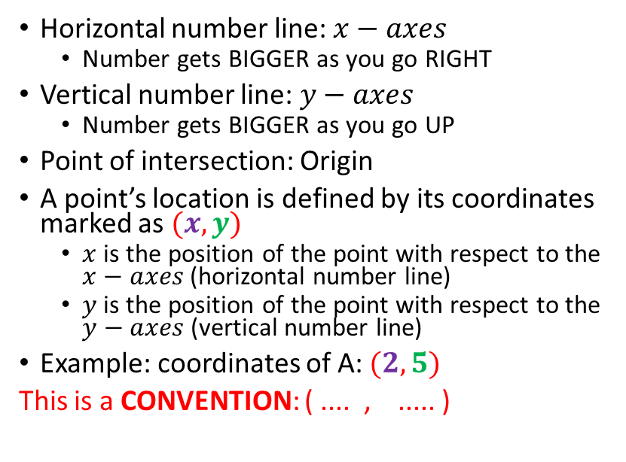
Using Coordinates
E
Horizontal number line: $x−axes$
Number gets BIGGER as you go RIGHT
Vertical number line: $y−axes$
Number gets BIGGER as you go UP
Point of intersection: Origin
A point’s location is defined by its coordinates marked as $(x,y)$
$x$ is the position of the point with respect to the $x−axes$ (horizontal number line)
$y$ is the position of the point with respect to the $y−axes$ (vertical number line)
Example: coordinates of A: $(2, 5)$
This is a CONVENTION: ( .... , ..... )
A
A
D
C
B
Origin
(0,0)
©AXM

Slide 9
Using Coordinates
ANSWERS
E
Horizontal number line: $x−axes$
Number gets BIGGER as you go RIGHT
Vertical number line: $y−axes$
Number gets BIGGER as you go UP
Point of intersection: Origin
A point’s location is defined by its coordinates marked as $(x,y)$
$x$ is the position of the point with respect to the $x−axes$ (horizontal number line)
$y$ is the position of the point with respect to the $y−axes$ (vertical number line)
Example: coordinates of A: $(2, 5)$
This is a CONVENTION: ( .... , ..... )
A
A
A (2,5); B(2,-5); C(-4,-2); D (-7,0); E (-1, 9)
D
C
B
Origin
(0,0)
©AXM

Slide 10
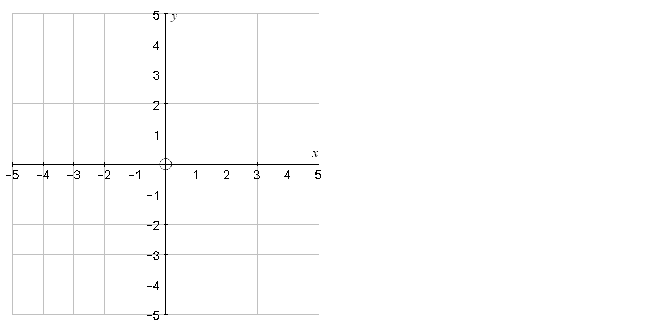
Coordinates in all 4 quadrants
Eg write down the coordinates of A, B, C and D
Eg Plot the coordinates:
(3,4)
F(0,4)
A
E(4,1)
D
(-3,2)
F(0,4)
E(4,1)
G(-2,-1)
H(4,-4)
G(-2,-1)
B
(1,-2)
(-5,-3)
C
H(4,-4)

Slide 11
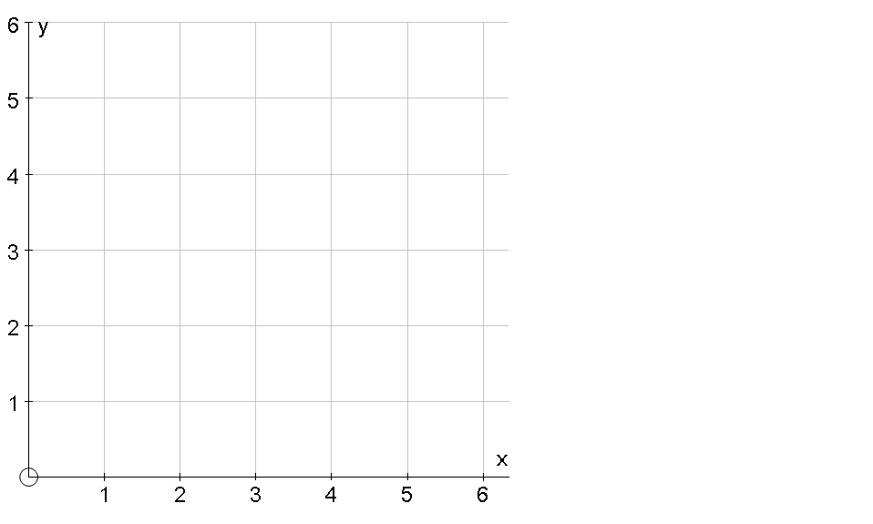
Find the point needed to make a rectangle
(6,3)

Slide 12
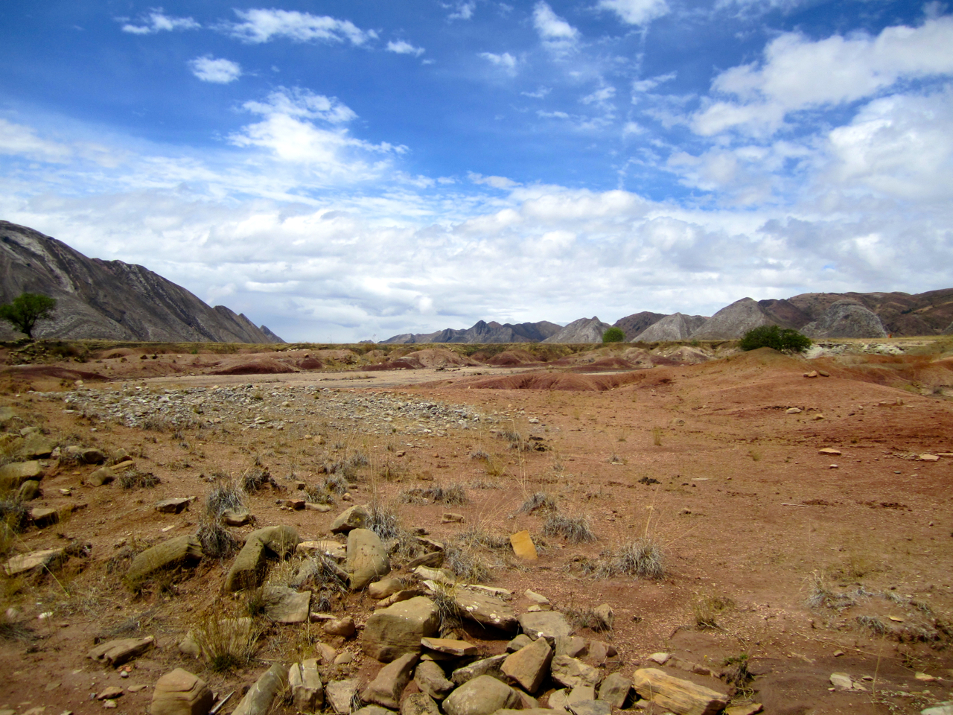
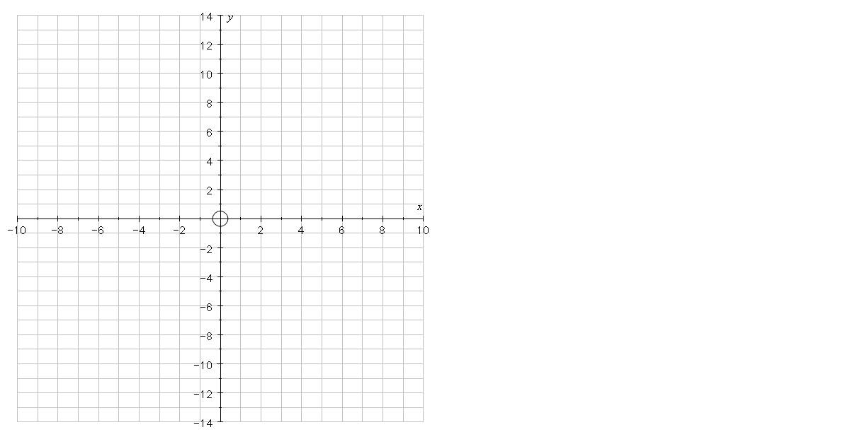

Coordinates
Connect the coordinates in order to draw a mystery creature
Body: (5,7) (5,6) (6,4) (2, -4) (0,-5) (-1,-6) (-2,-9) (-1,-11)
(0,-12) (0,-13) (-3,-12) (-3,-11)
(-4,-9) (-4,-6) (-6,-9) (-8,-11)
(-8,-12) (-1,-14) (-7,-14)
(-10,-13) (-10,-11) (-8,-9)
(-6,-3) (-5,1) (-3,3) (2,6) (2,10) (3,11) (5,12) (9,10) (9,9) (6,9) (9,8) (8,7) (5,7)
Arm:
(3,3) (5,1) (7,1) (7,0) (4,0) (2,2)
Front Leg:
(2,-4) (3,-11) (4,-12) (4,-13)
(1,-12) (1,-11) (0,-5)

Slide 13

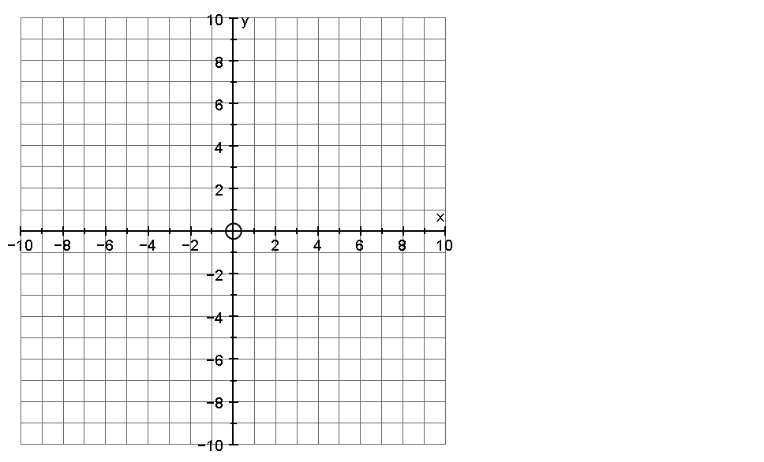
Coordinates
Connect the coordinates in order to draw a mystery object
Part 1: (0,10) (2,5) (2,0) (4, -2) (9,-2) (10,-4) (8,-6) (4,-5)
(1,-2) (2,-5) (3,-10) (1,-7)
(1,-10) (0,-9) (-1,-10) (-1,-7)
(-3,-10) (-2,-5) (-1,-2)
(-4,-5) (-8,-6) (-10,-4)
(-9,-2) (-4,-2) (-2,0) (-2,5) (0,10)
Part 2:
(6,-2) (6,3) (7,6) (8,3) (8,-2)
Part 3:
(-6,-2) (-6,3) (-7,6) (-8,3) (-8,-2)
Part 4:
(-8,-6) (-8,-8) (-7,-7) (-6,-8) (-6,-5½)
Part 5:
(8,-6) (8,-8) (7,-7) (6,-8) (6,-5½)

Slide 14
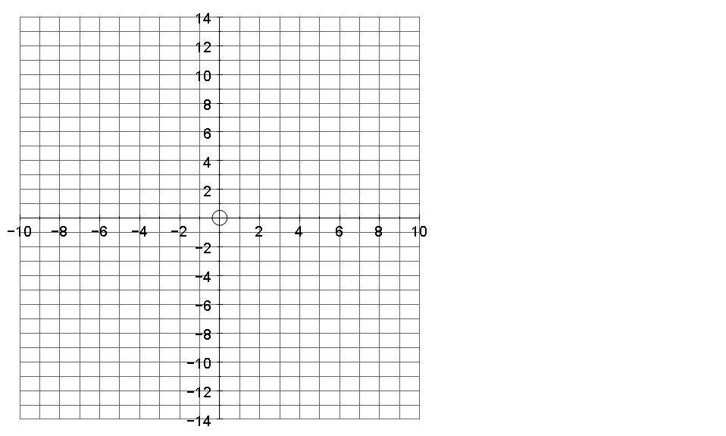
Coordinates
Connect the coordinates in order to draw a mystery creature
Body: (5,7) (5,6) (6,4) (2, -4) (0,-5) (-1,-6) (-2,-9) (-1,-11)
(0,-12) (0,-13) (-3,-12) (-3,-11)
(-4,-9) (-4,-6) (-6,-9) (-8,-11)
(-8,-12) (-1,-14) (-7,-14)
(-10,-13) (-10,-11) (-8,-9)
(-6,-3) (-5,1) (-3,3) (2,6) (2,10) (3,11) (5,12) (9,10) (9,9) (6,9) (9,8) (8,7) (5,7)
Arm:
(3,3) (5,1) (7,1) (7,0) (4,0) (2,2)
Front Leg:
(2,-4) (3,-11) (4,-12) (4,-13)
(1,-12) (1,-11) (0,-5)

Slide 15
Coordinates
Connect the coordinates in order to draw a mystery object
Part 1: (0,10) (2,5) (2,0) (4, -2) (9,-2) (10,-4) (8,-6) (4,-5)
(1,-2) (2,-5) (3,-10) (1,-7)
(1,-10) (0,-9) (-1,-10) (-1,-7)
(-3,-10) (-2,-5) (-1,-2)
(-4,-5) (-8,-6) (-10,-4)
(-9,-2) (-4,-2) (-2,0) (-2,5) (0,10)
Part 2:
(6,-2) (6,3) (7,6) (8,3) (8,-2)
Part 3:
(-6,-2) (-6,3) (-7,6) (-8,3) (-8,-2)
Part 4:
(-8,-6) (-8,-8) (-7,-7) (-6,-8) (-6,-5½)
Part 5:
(8,-6) (8,-8) (7,-7) (6,-8) (6,-5½)

